Slide 1

Log-distance Path Loss Model
Path Loss models to estimate the received signal level as a function of distance, it is possible to predict the SNR for a mobile communication.
The average signal power received decreases logarithmically with distance.
d- distance between the transmitter and receiver
d₀-Close-in reference distance
n- Path loss exponent which indicates rate at which the pass loss increases with distance
PL(d) $∝\left(\frac{d}{do}\right)\text{n}$
PL(dB)= PL(d₀) +10 nlog(d/d₀)

Slide 2
Log-distance Path Loss Model
Value of n depends on propagation environment.
n increases when obstructions are present.
Environment | Path loss Exponent n
Free Space | 2
Urban area cellular radio | 2.7 to 3.5
Shadowed urban area | 3 to 5
In building Line of sight | 1.6 to 1.8
Obstructed in building | 4 to 6
Obstructed in factories | 2 to 3

Slide 3
Log-normal Shadowing
Log distance does not consider the fact that surrounding environment clutter may be different at two different locations having same T-R distance.
Hence measured signals vary than the average value predicted.
Log-normal shadowing model used.

Slide 4
Shadowing
What is shadowing?
shadowing is deviation of the power of the received electromagnetic signal from an average value.
Causes for Shadowing
Caused by obstacles affecting the wave propagation.
May vary with geographical position and/or radio frequency.
Usually modelled as a random process.

Slide 5
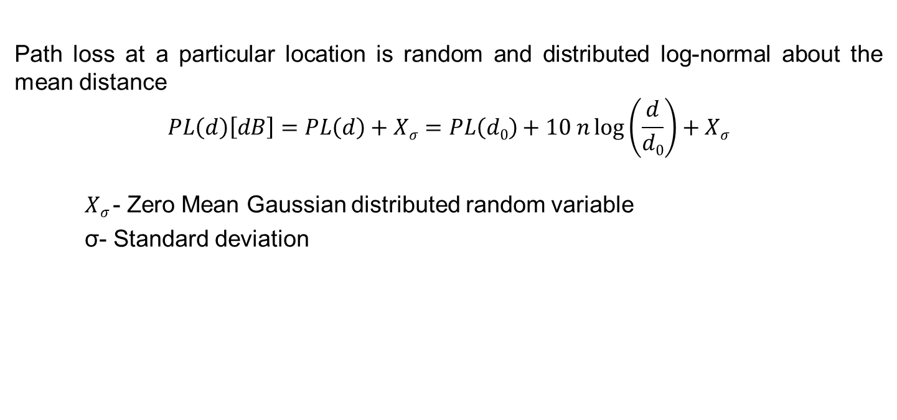
Log-normal Shadowing
Path loss at a particular location is random and distributed log-normal about the mean distance
$$PL\left(d\right)\left[dB\right]=PL\left(d\right)+Xσ=PL\left(d0\right)+10 n\log\left(\frac{d}{d0}\right)+Xσ$$
$Xσ$- Zero Mean Gaussian distributed random variable
σ- Standard deviation

Slide 6
Summary
Two path loss models considered for estimation of the received signal.
Log distance model does not take into consideration the surrounding environmental clutter at two different locations with same T-R distance.
Log-normal shadowing model, path loss at a particular location is random and is distributed log-normal about the mean distance.

